Slide 1

Introduction to RabbitMQ
Pravinkumar R .D.

Slide 2
What is RabbitMQ?
RabbitMQ is a open source message broker
It offers two important roles –
Producer
Consumer
Broker
RabbitMQ
Producer
Publish
Consume
Consumer
Message
Subscrition to Broker

Slide 3
Why RabbitMQ?
As we are going to use PM2 to create and manage processes, we can not establish communication between master and child
The control is now with PM2
You can not use the methods which we saw in our last example
With RabbitMQ, we can distribute messages to multiple consumers.
Also we can load balance between the workers

Slide 4
Core of RabbitMQ
Producer –
The application/process which sends the messages
Consumer –
The application/process which receives the messages
Queue –
The message store
Message –
The message/information sent by producer to the consumer

Slide 5
Core of RabbitMQ
Channel –
A medium using which we can send messages or receive messages is called channel
AMQP –
Advance Message Queue Protocol used by RabbitMQ for messaging

Slide 6
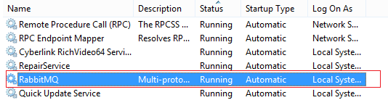
Install RabbitMQ
Download and install RabbitMQ
https://www.rabbitmq.com/install-windows.html#installer
Download and install RabbitMQ which will install RabbitMQ as Windows Service

Slide 7
Install ‘amqplib’ Package using NPM
To use RabbitMQ in our Node JS Express application, we need to install a package ‘amqplib’ using NPM install command
npm install --save amqplib
It is a library and client for Node JS

Slide 8
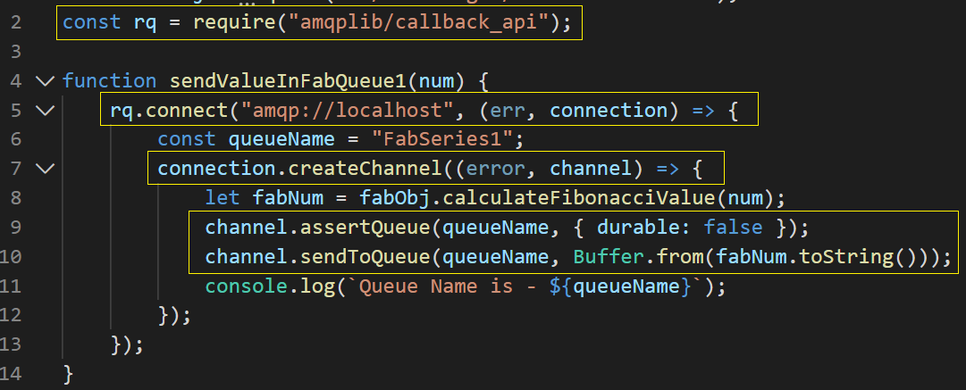
Create Producer

Slide 9
Create Producer
Import amqplib package
Connect with RabbitMQ server using connect method
It takes two parameter –
URL – we are using default url which is ‘’amqp://localhost”
Call back function
Connection offers a createChannel function which takes two parameters –
err
channel

Slide 10
Create Producer
assertQueue –
Assert the queue existence
sendToQueue –
Sends a message to queue

Slide 11
Create Consumer
Most of the code to create consumer is same as producer except, instead of using sendToQueue() method, we will use consume() method
The method takes two parameters –
Queue Name
Call back function - which receives the message from the given queue

Slide 12
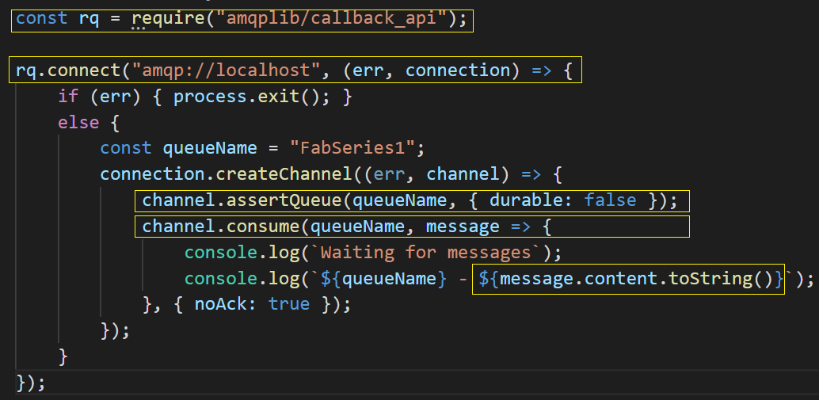
Create Consumer

Slide 13
List Queues
Go to the path –
C:\Program Files\RabbitMQ Server\rabbitmq_server-3.8.2\sbin
Open the path in command prompt and type a command –
rabbitmqctl list_queues
Using this command you will see all the queues from RabbitMQ

Slide 14
Using RabbitMQ Web Interface
To see all the queues and their details, we can use RabbitMQ web interface –
To open web interface, open a browser and type below URL –
http://localhost:15672/
It will open web interface. The user Id is guest and password is guest

